Slide 1

Improving Customer Satisfaction to drive profits for the veterinary chain VCA Using predictive analytics to identify factors impacting sales
Team Members:
Akumalla, Mounika
Wang, Yu-Min
Shivaram, Aravindraamanathan
Kare, Shashank
GROUP NO: 4

Slide 2
Index
Objective
Executive Summary
Hospital Segments & Revenue Share
Hospital Customer Segment Behavior
First Time Customers Strategy
Repeat Time Customers Strategy
Financial Implications & ROI
Test & Learn Plan

Slide 3






Objective
VCA Animal Hospitals is a trade name of veterinary medicine company VCA, Inc., an operator of veterinary hospitals in the US and Canada
The analysis aims to identify critical parameters that can increase the total units purchased by customers at different VCA chains, in order to increase overall net revenue
The study is carried out on 412 hospitals of VCA by modelling aspects such as customer satisfaction, hospital reputation, first time visitors , number of units purchased by first time and repeat visitors

Slide 4
Executive Summary

Slide 5

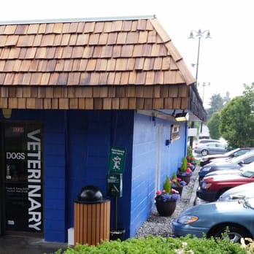
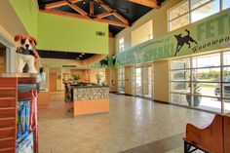
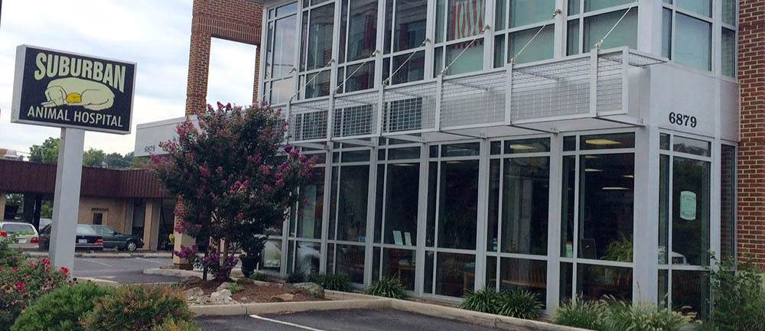
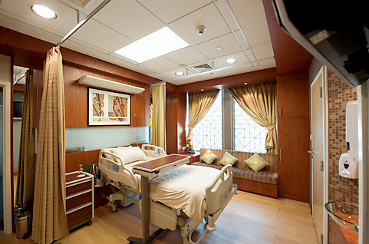
Hospital Segments & Revenue Share
Satisfiers
Lag-gers
Remodeled Strugglers
Suburban Achievers
Revenue Leaders
Satisfiers have the highest hospital share (25%) while Revenue Leaders (10%) are clearly the most profitable (2.2X)
Lag-gers are the least profitable segment of all

Slide 6

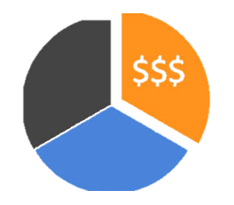









Hospital Segment Attributes
Satisfiers
Lag-gers
Remodeled Strugglers
Suburban Achievers
Revenue Leaders
Hospitals Share (%)
Revenue Share (%)
Profitability
Customer Satisfaction
Hospital Reputation
Medical Quality
Hospital Culture
Customer Service
Staff Performance
Employee Engagement
Operational Efficiency
Operational Hours

Slide 7






Hospital Segment Customer Attributes
Satisfiers
Lag-gers
Remodeled Strugglers
Suburban Achievers
Revenue Leaders
Population (hh*)
Average Age
Urban / Suburban / Rural
Number of hh* with pets
Pet Expenditure per hh*
Online lead conversion
First visit units
First visit discounts
First visit price
Repeat Visit Units
Repeat Visit Discount
Repeat Visit Price
*hh means households

Slide 8
Hospital Customer Behavior
Variable | Satisfiers | Laggers | Remodeled Strugglers | Suburban Achievers | Revenue Leaders
rev_2014 | 1,455,593 | 865,547 | 1,568,982 | 2,315,354 | 3,763,494
first_rev_2014 | 91,155 | 67,318 | 128,738 | 159,751 | 568,290
repeat_revenue_2014 | 1,364,438 | 798,230 | 1,440,244 | 2,155,603 | 3,195,204
num_clients_2014 | 2,301 | 1,370 | 2,639 | 3,662 | 5,866
num_new_clients_2014 | 616 | 421 | 822 | 1,107 | 2,059
num_patients_2014 | 3,264 | 1,879 | 3,621 | 5,174 | 7,905
num_new_patients_2014 | 1,142 | 728 | 1,426 | 2,014 | 3,566
num_visits_2014 | 10,694 | 6,108 | 11,083 | 16,417 | 21,573
units_2014 | 134,318 | 82,554 | 148,727 | 217,841 | 371,917
first_visit_units_2014 | 7,289 | 5,609 | 10,835 | 14,257 | 44,722
repeat_units_2014 | 127,029 | 76,944 | 137,892 | 203,584 | 327,195
Marketing_spend_2014 | 5,866 | 4,706 | 6,616 | 8,166 | 11,310
Overall_sat_2014 | 6.62 | 6.51 | 6.41 | 6.58 | 6.37
Reputation_Score_2014 | 298 | 276 | 335 | 358 | 370
Service_Radius | 5.5 | 5.5 | 4.9 | 6.0 | 6.9
Remodel_amt | 78,657 | 47,791 | 100,741 | 60,102 | 72,800
total_population | 32,382 | 31,487 | 34,706 | 37,845 | 34,711
total_hh | 12,428 | 12,115 | 13,641 | 14,685 | 13,223
urban_hh | 2,632 | 2,576 | 5,310 | 4,570 | 5,838
suburban_hh | 4,436 | 4,047 | 4,303 | 5,173 | 2,802
second_city_hh | 3,642 | 3,568 | 2,763 | 3,721 | 2,597
pet_expenditures_2014 | 8,564,586 | 8,168,426 | 9,187,055 | 9,872,584 | 8,410,845
pet_expend_per_hh | 708 | 692 | 687 | 678 | 668
perc_home_ownership | 63 | 60 | 58 | 59 | 56
perc_married_hh | 51 | 49 | 48 | 49 | 47
MEDIAN_HH_INCOME | 70,117 | 67,924 | 69,358 | 67,040 | 65,489
AGGR_HH_NETWORTH | 5,004,252,916 | 4,736,642,666 | 5,249,168,643 | 5,698,234,762 | 4,624,565,093
MEDIAN_HH_NETWORTH | 83,929 | 76,811 | 64,862 | 71,734 | 69,729
age_HH_NETWORTH | 423,385 | 405,747 | 394,784 | 392,978 | 379,922
num_competition | 39 | 41 | 40 | 51 | 59
hours_open | 63 | 61 | 68 | 70 | 110
skills_abilities_2014 | 85.3 | 82.8 | 82.6 | 84.6 | 80.7
Revenue Leaders are best in hospital reputation , open for the maximum hours but lowest on customer satisfaction while Satisfiers are quite the opposite
Revenue Leaders & Remodeled Strugglers cater to the urban population while others to suburban & rural

Slide 9
Hospital Customer Behavior
Variable | Satisfiers | Laggers | Remodeled Strugglers | Suburban Achievers | Revenue Leaders
personal_accomplishment_2014 | 83.6 | 77.0 | 82.5 | 82.0 | 75.9
good_place_work_2014 | 66.6 | 65.4 | 66.2 | 71.1 | 59.4
help_org_succeed_2014 | 87.4 | 85.2 | 87.0 | 87.3 | 81.2
safe_express_views_2014 | 74.1 | 73.8 | 72.5 | 71.6 | 69.1
respect_amongst_peers_2014 | 84.6 | 81.9 | 80.2 | 81.7 | 73.5
treated_fairly_2014 | 69.9 | 67.0 | 67.3 | 70.0 | 63.6
long_term_future_2014 | 70.5 | 62.3 | 67.3 | 70.0 | 65.5
well_managed_2014 | 65.6 | 61.0 | 63.2 | 64.4 | 57.5
perf_appraisal_adequate_2014 | 60.8 | 58.7 | 59.9 | 61.1 | 51.3
defined_perf_goals_2014 | 73.6 | 68.9 | 74.9 | 77.0 | 67.7
match_pay_to_perf_2014 | 30.1 | 27.9 | 29.7 | 30.7 | 22.5
quality_medicine_2014 | 92.3 | 87.8 | 90.7 | 92.9 | 85.4
client_experience_2014 | 95.1 | 87.8 | 90.5 | 93.6 | 88.0
best_for_the_pet_2014 | 93.0 | 89.3 | 89.6 | 90.4 | 83.7
feelings_pet_owners_2014 | 90.1 | 86.8 | 85.3 | 86.6 | 76.1
paid_worth_2014 | 32.9 | 30.2 | 31.1 | 34.0 | 27.9
benefits_meet_needs_2014 | 51.3 | 53.2 | 50.4 | 49.9 | 47.0
employee_cooperation_2014 | 78.4 | 79.6 | 73.2 | 73.7 | 67.7
growth_development_2014 | 61.7 | 57.6 | 61.6 | 63.2 | 58.2
access_equip_tools_2014 | 77.9 | 71.5 | 79.4 | 82.3 | 75.3
amt_work_reasonable_2014 | 76.2 | 71.6 | 74.2 | 74.8 | 70.2
work_life_balance_2014 | 66.8 | 60.8 | 65.0 | 64.9 | 62.0
CMT_closed_leads | 461.7 | 325.1 | 549.2 | 890.7 | 974.3
CMT_expired_leads_num | 42.7 | 33.5 | 39.0 | 39.6 | 103.6
CMT_visits | 218.3 | 139.1 | 253.8 | 421.9 | 445.0
shelter_patients_permth | 38.5 | 0.2 | 15.1 | 44.5 | 23.2
turnover_admin | 2.1 | 1.8 | 2.5 | 2.5 | 3.4
turnover_Kennel_Groomer | 1.9 | 2.0 | 2.1 | 2.6 | 2.4
turnover_Manager | 1.3 | 1.2 | 1.3 | 1.0 | 1.4
turnover_Tech | 2.1 | 1.8 | 2.3 | 2.5 | 4.4
count_admin | 3.7 | 2.3 | 4.5 | 6.0 | 9.7
count_kennel_groomer | 3.1 | 1.8 | 3.1 | 4.8 | 5.1
count_tech | 5.6 | 3.6 | 5.9 | 9.0 | 16.7
count_vet | 3.5 | 3.0 | 4.1 | 4.7 | 9.8
vet_to_manager | 3.4 | 3.0 | 4.1 | 4.6 | 9.7
Revenue Leaders are best in online conversions, employee count but are the lowest on employee engagement, staff performance, quality medical, operational efficiency & hospital culture
Laggers have the highest employee cooperation and need- benefits ratio not yielding much revenue, while suburban achievers have the lowest turnover per manager

Slide 10
Hospital Segment First Visit Strategy
+10%
YoY_sat
+49
First Visit Price
CMT_visits
Elasticity = 1.1
Elastic segment , DECREASE REPEAT PRICE by
+10%
CMT_conversion
+35
Increased by 84
Satisfiers
+84
CMT_visits
+57
FIRST VISIT UNITS
+$10,000
Mkt spend 2014
+68
Number of new clients
+1,272
+$1,000
First visit discount 2014
+10
Increased by 159
+1272
- 5%
Valid emails 2014
+24
Increase in revenue by $18,256

Slide 11




Hospital Segment Repeat Visit Strategy
Manager Count
+0.76
Customer Satisfaction
Repeat Price
+16,955
Vet Communication
+0.08
Elasticity = 0.8
Inelastic segment , INCREASE REPEAT PRICE by
Increase in satisfaction by 1.1 points
Improve customer response score by 0.5
Payment Options
+0.25
Satisfiers
First Visit Discounts (YOY)
+1,158
REPEAT UNITS
Valid Remainders 2014
+371
Increase YOY first visit discounts as % of revenue by 0.1% i.e., $13,644
+21,269
+$1,000
Overall Discount 2014
+3.5
Kennel Groomer Count
+18.5
Years of Tech Expertise
Number of repeat clients
Increase in revenue by $235,691
+5.74
+3,156
Valid Emails 2014
+665
Increase in number of clients by 1,578
Do not advertise
Retired Community
-$1,196
Repeat Discount
+513.8

Slide 12
Hospital Segment First Visit Strategy
+10%
YoY_sat
+9
CMT_visits
First Visit Price
+10%
CMT_conversion
+30
Increased by 39
Elasticity = 1.1
Elastic segment , DECREASE REPEAT PRICE by
+39
CMT_visits
+31
Lag-gers
Number of new clients
+$5000
First visit discount
+54
+896
Increased by 112
FIRST VISIT UNITS
- 10%
Valid emails 2014
+27
+1312
YoY staff friendly
+296
increased by 1%
Increase in revenue by $19,576
Staff yrs experience
+120
increased by 1 year

Slide 13
Hospital Segment Repeat Visit Strategy
Manager Count
+0.76
Customer Satisfaction
Repeat Price
+16,955
Vet Communication
+0.08
Elasticity = 0.8
Inelastic segment , INCREASE REPEAT PRICE by
Increase in satisfaction by 1.1 points
Improve customer response score by 0.5
Payment Options
+0.25
Lag-gers
First Visit Discounts (YOY)
+1,158
REPEAT UNITS
Valid Remainders 2014
+371
Increase YOY first visit discounts as % of revenue by 0.1% i.e., $13,644
+21,269
+$1,000
Overall Discount 2014
+3.5
Kennel Groomer Count
+18.5
Years of Tech Expertise
Number of repeat clients
Increase in revenue by $235,691
+5.74
+3,156
Valid Emails 2014
+665
Increase in number of clients by 1,578
Do not advertise
Retired Community
-$1,196
Repeat Discount
+513.8

Slide 14
Hospital Segment First Visit Strategy
CMT_visits
First Visit Price
+10%
CMT_conversion
+30
Increased by 30
Elasticity = 1.1
Elastic segment , DECREASE REPEAT PRICE by
+30
CMT_visits
+8
Remodeled Strugglers
+$1000
First visit discount
+120
Number of new clients
+1480
FIRST VISIT UNITS
Increased by 185
- 10%
Valid emails 2014
+57
+1722
Own_timeshare_no
Increase in revenue by $23,658
+242
decreased by 2%

Slide 15
Hospital Segment Repeat Visit Strategy
Manager Count
+0.76
Customer Satisfaction
Repeat Price
+16,955
Vet Communication
+0.08
Elasticity = 0.8
Inelastic segment , INCREASE REPEAT PRICE by
Increase in satisfaction by 1.1 points
Improve customer response score by 0.5
Payment Options
+0.25
Remodeled Strugglers
First Visit Discounts (YOY)
+1,158
REPEAT UNITS
Valid Remainders 2014
+371
Increase YOY first visit discounts as % of revenue by 0.1% i.e., $13,644
+21,269
+$1,000
Overall Discount 2014
+3.5
Kennel Groomer Count
+18.5
Years of Tech Expertise
Number of repeat clients
Increase in revenue by $235,691
+5.74
+3,156
Valid Emails 2014
+665
Increase in number of clients by 1,578
Do not advertise
Retired Community
-$1,196
Repeat Discount
+513.8

Slide 16
Hospital Segment First Visit Strategy
CMT_visits
First Visit Price
+10%
CMT_conversion
+91
Increased by 91
Elasticity = 1.1
Elastic segment , DECREASE REPEAT PRICE by
+91
CMT_visits
+51
Suburban Achievers
+50
Reputation score
+31
Number of new clients
+1,176
+$1,000
First visit discount 2014
+13
Increased by 147
FIRST VISIT UNITS
- 5%
Valid emails 2014
+52
+1330
Mkt spend 2014
+154
Increase in revenue by $17,777
decreased by $200

Slide 17
Hospital Segment Repeat Visit Strategy
Manager Count
+0.76
Customer Satisfaction
Repeat Price
+16,955
Vet Communication
+0.08
Elasticity = 0.8
Inelastic segment , INCREASE REPEAT PRICE by
Increase in satisfaction by 1.1 points
Improve customer response score by 0.5
Payment Options
+0.25
Suburban Achievers
First Visit Discounts (YOY)
+1,158
REPEAT UNITS
Valid Remainders 2014
+371
Increase YOY first visit discounts as % of revenue by 0.1% i.e., $13,644
+21,269
+$1,000
Overall Discount 2014
+3.5
Kennel Groomer Count
+18.5
Years of Tech Expertise
Number of repeat clients
Increase in revenue by $235,691
+5.74
+3,156
Valid Emails 2014
+665
Increase in number of clients by 1,578
Do not advertise
Retired Community
-$1,196
Repeat Discount
+513.8

Slide 18
Hospital Segment First Visit Strategy
+10%
CMT_conversion
First Visit Price
+115
CMT_visits
Increased by 115
Elasticity = 1.1
Elastic segment , DECREASE REPEAT PRICE by
+115
CMT_visits
+112
+50
Reputation score
+134
Revenue Leaders
Number of new clients
+2600
+$5,000
First visit discount 2014
+43
FIRST VISIT UNITS
Increased by 325
- 1%
Valid emails 2014
+36
+3408
Perc_shelter patient
+808
Increase in revenue by $45,949
Increased by 1%

Slide 19
Hospital Segment Repeat Visit Strategy
Manager Count
+0.76
Customer Satisfaction
Repeat Price
+16,955
Vet Communication
+0.08
Elasticity = 0.8
Inelastic segment , INCREASE REPEAT PRICE by
Increase in satisfaction by 1.1 points
Improve customer response score by 0.5
Payment Options
+0.25
Revenue Leaders
First Visit Discounts (YOY)
+1,158
REPEAT UNITS
Valid Remainders 2014
+371
Increase YOY first visit discounts as % of revenue by 0.1% i.e., $13,644
+21,269
+$1,000
Overall Discount 2014
+3.5
Kennel Groomer Count
+18.5
Years of Tech Expertise
Number of repeat clients
Increase in revenue by $235,691
+5.74
+3,156
Valid Emails 2014
+665
Increase in number of clients by 1,578
Do not advertise
Retired Community
-$1,196
Repeat Discount
+513.8

Slide 20
Test & Learn Plan
Satisfiers
Lag-gers
Remodeled Strugglers
Suburban Achievers
Revenue Leaders
Increase Mkt spend $5000 => $10000
Increase 1st visit disc $2500 => $5000
Decrease valid email
-5% => -10%
Increase YoY_staff friendly 0.5% => 1%
Increase Staff_yrexp
0.5yr => 1yr
Increase YoY_sat 5% => 10%
Increase CMT_conv
5% => 10%
Increase 1st visit disc $500 => $1000
Decrease valid email
-5% => -10%
Increase Owntme share_no 1% => 2%
Increase CMT_conv
5% => 10%
Increase 1st visit disc $500 => $1000
Decrease valid email
-2.5% => -5%
Increase Repu_score
25 => 50
Increase Mkt spend
$100 => $200
Increase CMT_conv
5% => 10%
Increase 1st visit disc $2500 => $5000
Decrease valid email
-0.5% => -1%
Increase Repu_score
25 => 50
Increase Prc_shlt_pat
0.5% => 1%
Increase CMT_conv
5% => 10%
Increase 1st visit disc $500 => 1000
Decrease valid email
-2% => -5%
Increase YoY_sat 5% => 10%
Increase CMT_conv
5% => 10%

Slide 21
Financial Implications & ROI

